Slide 1
Social Media Website

Slide 2


BLOG POST WEBSITE
LMS username | Name | Batch
2115a248 | Vishnu MS | A2
2115a242 | Senthil Kumar V | A2
2115a255 | Santhosh G | A2
2115a253 | Narayanan R | A2

Slide 3
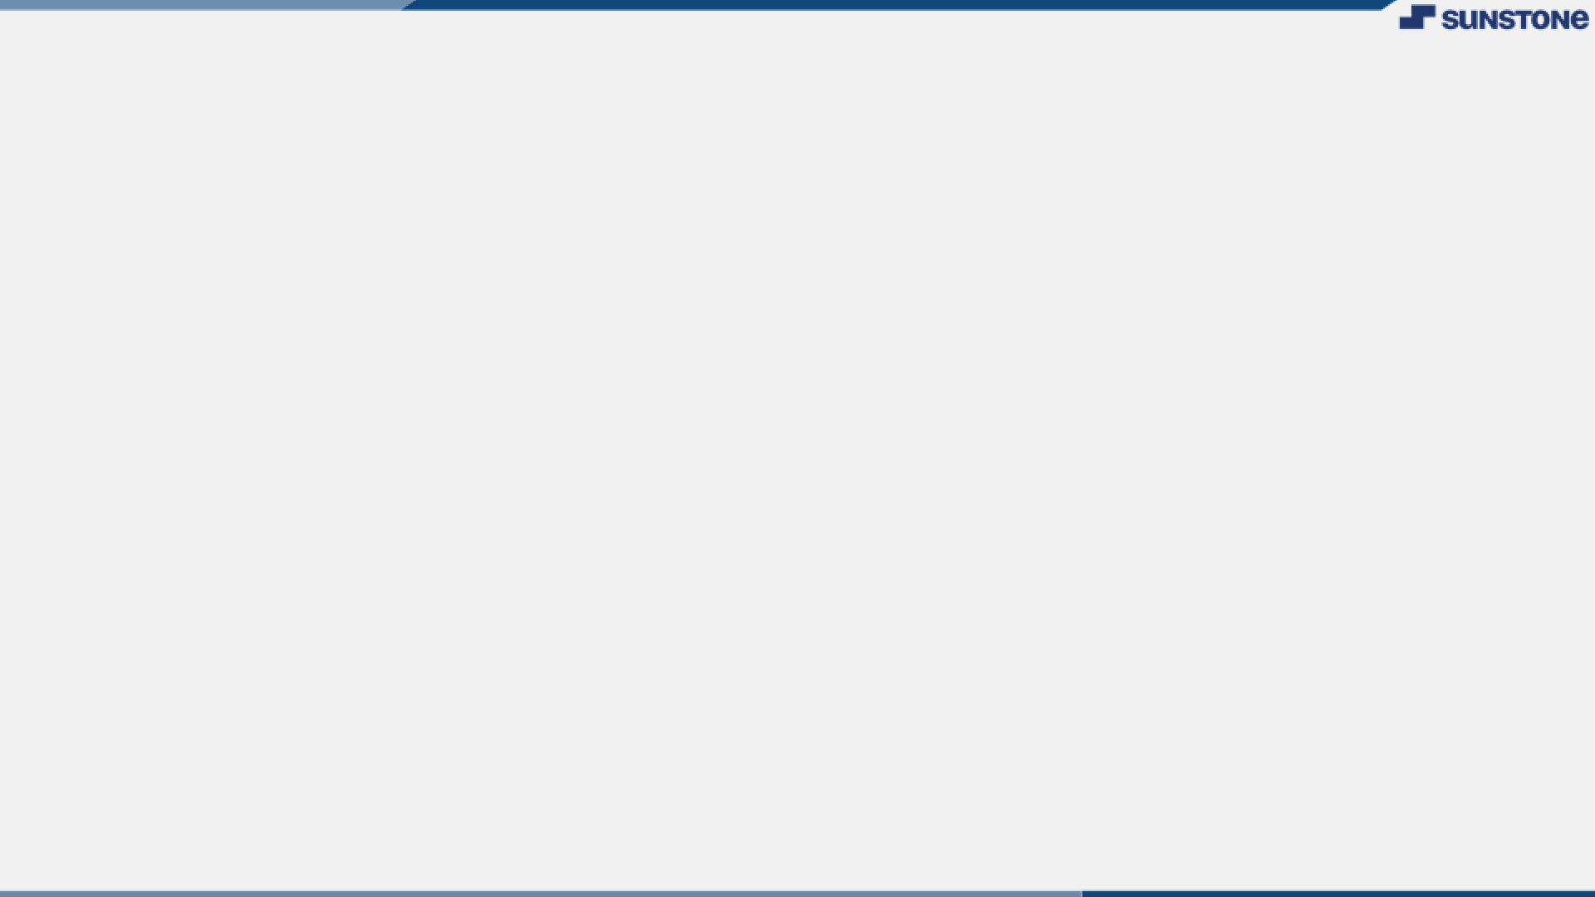

INTRODUCTION
Social media websites are online platforms that allow users to create and share content, connect with other users, and interact with content posted by others. Social media websites can include social networking sites like Facebook and LinkedIn, microblogging sites like Twitter, video-sharing sites like YouTube, and photo-sharing sites like Instagram.
Social media websites have become incredibly popular in recent years,
with billions of users worldwide. They have transformed the way we communicate, connect, and share information online, and have created new opportunities for businesses, marketers, and individuals to reach wider audiences.
Social media websites typically offer a range of features and tools that
allow users to create and share different types of content, such as text, images, videos, and links. They also enable users to connect with others by following or friending them, and to engage with content by liking, commenting, and sharing.

Slide 4


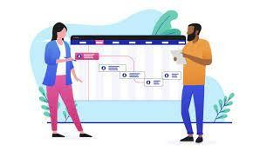
CUSTOMERS
Everyone anyone can able to use this website ranging from children to old people.
The major target of this website are college students.
Many reachers, scientist,project managers,and many peoples use blog to gain info and also
study new technologies by blog only

Slide 5
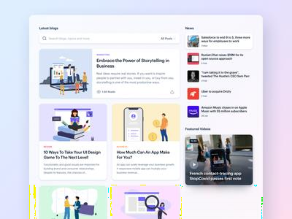
Functional requirements:
User Registration and Authentication: Users should be able to create an account on the website and authenticate themselves to access the website's features.
Profile Creation and Management: Users should be able to create and manage their profiles, which may include information such as their name, profile picture, bio, and interests.
Content Creation and Sharing: Users should be able to create and share
various types of content, such as text posts, images, videos, and links, with
other users.
User Engagement Features: Users should be able to engage with content
posted by other users, such as by liking, commenting, sharing, or saving the
content.
Privacy and Security: The website should implement appropriate measures
to ensure the privacy and security of user data, such as by using secure protocols for data transmission and storage and implementing access controls and user permissions.
Messaging and Communication: Users should be able to communicate with
other users using messaging and communication features, such as direct
messaging, group messaging, and video calling.
Analytics and Reporting: The website should provide analytics and
reporting features to help users understand their engagement and performance on the website, such as by providing metrics on user activity, content performance, and engagement levels.

Slide 6

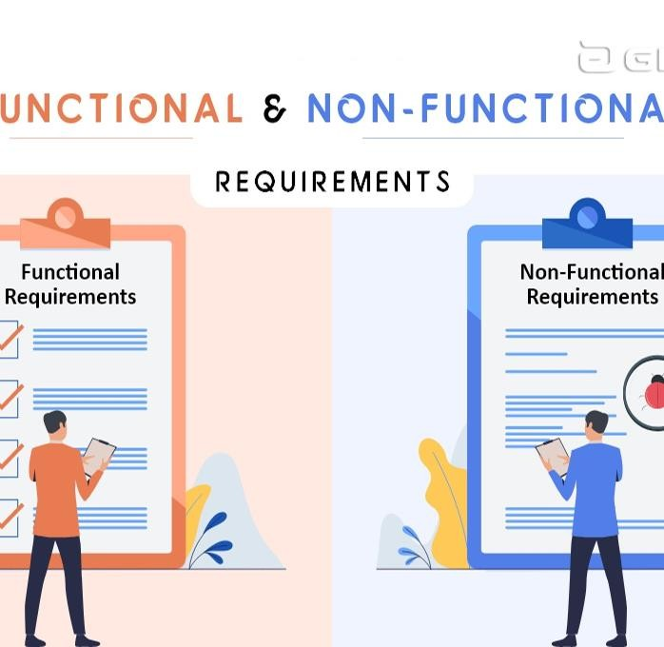
Non-functional requirements :
Performance: The website should be able to handle a large number of users and user activity without significant performance issues, such as slow load times or server crashes.
Availability: The website should be available to users at all times,
with minimal downtime or maintenance windows.
Usability: The website should be user-friendly and easy to navigate, with intuitive interfaces and clear instructions for using its features.
Security: The website should be secure, with appropriate measures in place to protect user data and prevent unauthorized access, such as encryption, firewalls, and access controls.
Scalability: The website should be able to scale up or down as needed to accommodate changes in user demand, such as by adding or removing servers or resources.
Accessibility: The website should be accessible to users with disabilities, such as by providing alternative text for images and videos and by using accessible design principles.
Compatibility: The website should be compatible with various
devices and browsers, ensuring that users can access it on their preferred platforms and devices.
Reliability: The website should be reliable, with minimal errors or
bugs that could impact user experience or data integrity.

Slide 7

TECHNICAL PROCESS
Following would be the languages I would use to develop my application within the
stipulated time period:
Front-end development: The front-end of a social media website involves designing and implementing the user interface and user experience (UI/UX) for the website using technologies such as HTML, CSS, and JavaScript. This includes developing various features such as user registration, profile creation, content creation and sharing, search and discovery, and user engagement features.
Back-end development: The back-end of a social media website involves developing
the server-side of the website using technologies such as PHP, Ruby on Rails, or Node.js. This includes implementing user authentication and authorization, database management, and server-side processing of user data and requests.
Database development: Social media websites require a database to store user data
and content. The database may be developed using technologies such as MySQL, MongoDB, or PostgreSQL, and should be designed to accommodate a large amount of data and handle high traffic.
Cloud infrastructure: To support a large user base, a social media website may be hosted on cloud infrastructure such as Amazon Web Services (AWS) or Microsoft Azure. This involves configuring and managing servers, load balancers, and other infrastructure components to ensure high availability and performance.
Third-party integrations: Social media websites often integrate with third-party services and APIs to enhance functionality and improve user experience. Examples include integrating with social media sharing APIs, payment gateways, and
messaging platforms.
Testingand Quality Assurance: To ensure that the website functions properly and meets user requirements, testing and quality assurance should be performed at every stage of development. This includes testing user interfaces, functionality, security, and performance.
Maintenance and Support: Once the website is launched, ongoing maintenance and
support is required to ensure that the website remains stable, secure, and up-to-date with the latest technologies and security standards. This involves monitoring website performance, identifying and fixing bugs and issues, and providing technical support to users.

Slide 8

GOALS AND SCOPES
Connect people: The primary goal of social media websites is to connect people and facilitate communication and interaction. Social media websites provide a platform for users to connect with friends, family, and acquaintances, and to meet new people with shared interests.
Share content: Social media websites enable users to create, share, and
consume content of various types, such as text, images, videos, and links. The scope of a social media website may include features such as blogging, photo sharing, video sharing, and link sharing.
Entertainment: Social media websites provide a platform for entertainment and leisure activities such as watching videos, playing games, and browsing content that matches the user's interests.
Marketing and Promotion: Social media websites offer an opportunity for businesses and brands to market their products and services and promote their brand to a wide audience. The scope of a social media website may include features such as advertising, sponsored content, and influencer marketing.
Networking and Professional Development: Some social media websites, such as LinkedIn, have a scope that focuses on professional networking and development. These websites provide a platform for job seekers and professionals to connect with each other, share industry knowledge, and find new job opportunities.
Overall, the scope and goals of a social media website should align with the needs and preferences of its target audience, and provide a valuable service or experience for its users.

Slide 9


ADD LINK
Blog post website

Slide 10


